Slide 1


USER MANUAL – ATTENDANCE REGISTRATION AND CONTROL SYSTEM

Slide 2
INTRODUCTION
Welcome to the Attendance Registration and Control System.This manual aims to provide a detailed guide on how to use the system, making it easier to understand and maximizing operational efficiency.It is intended for end users, administrators, and anyone who needs to interact with the platform.
The system allows for user management, attendance control, report generation, and real-time notifications, ensuring efficient and organized administration.

Slide 3
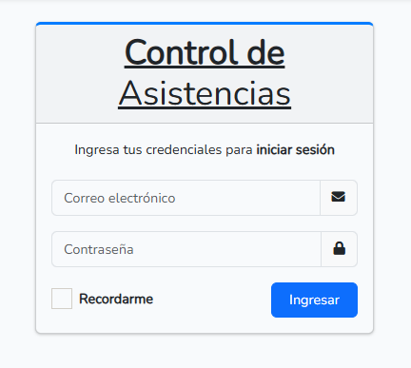
Access and Authentication
To access the system, the administrator must have created your user account beforehand.
Enter the email
Enter the password
Click on “Ingresar” (Login)

Slide 4
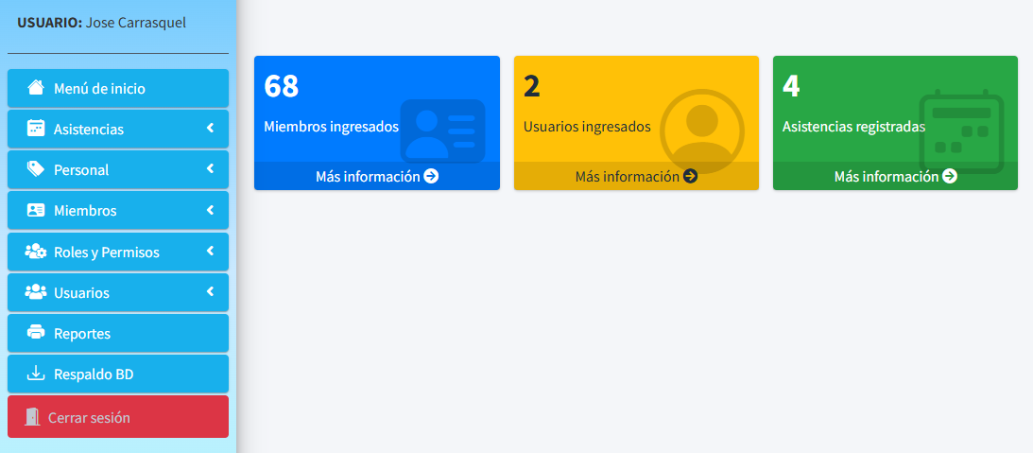
Main Dashboard
The Main Dashboard is the first interface displayed after logging in. From here, users can access different sections of the system according to their role and assigned permissions.
Information Board: Displays a real-time summary of recent activities.
Quick Access Buttons: Allow fast access to registered Members, Users, and Attendance records.
Navigation Menu: Provides access to the system’s functionalities.

Slide 5
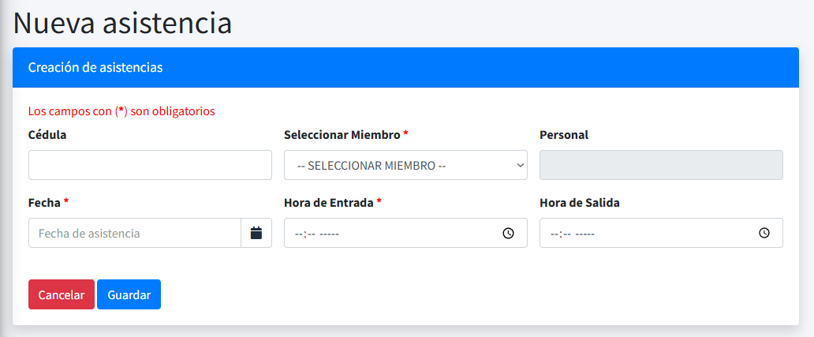
Attendance
The Attendance functionality allows registering and monitoring the check-in and check-out times of members, ensuring better control and tracking.
Enter the member’s ID number or select a registered member.
2. Enter the attendance date, check-in time, and/or check-out time.
3. Confirm the record.

Slide 6
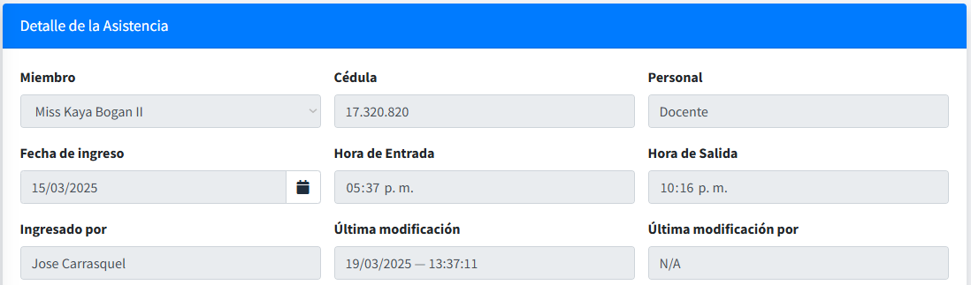
Attendance
Important Note: Any attendance created or modified by a user will remain registered in the system. When viewing a specific attendance record, three additional details are shown:
The user who registered the attendance.
2. The date and time of creation or last modification.
3. If modified, which user made the change. If not, it will display N/A.

Slide 7
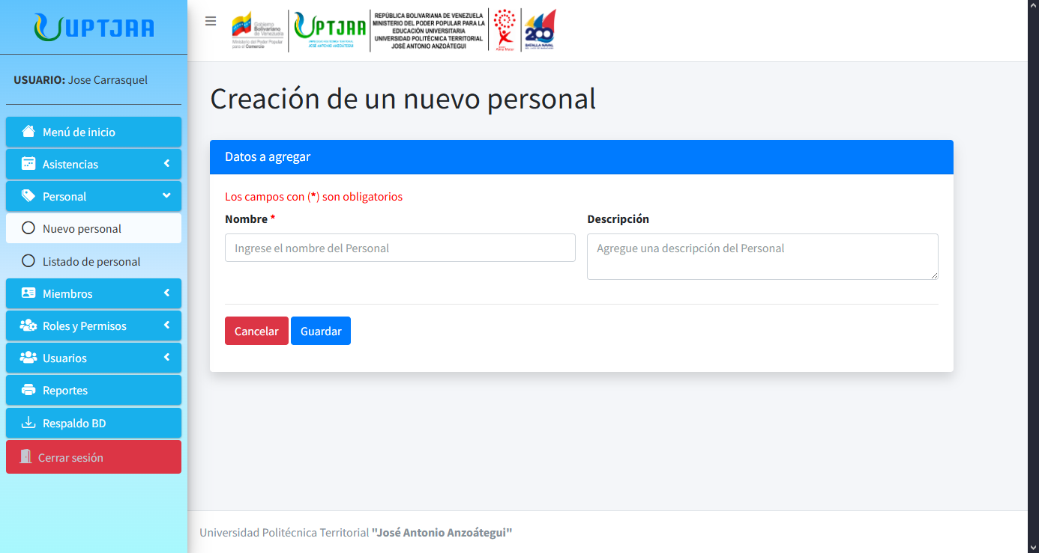
Staff
The system allows management of organizational roles, assigning them to registered members to reflect their responsibilities.
Assign the type of Staff to be added to the institution.
Provide a brief description of their responsibilities.
3. Confirm the record.

Slide 8
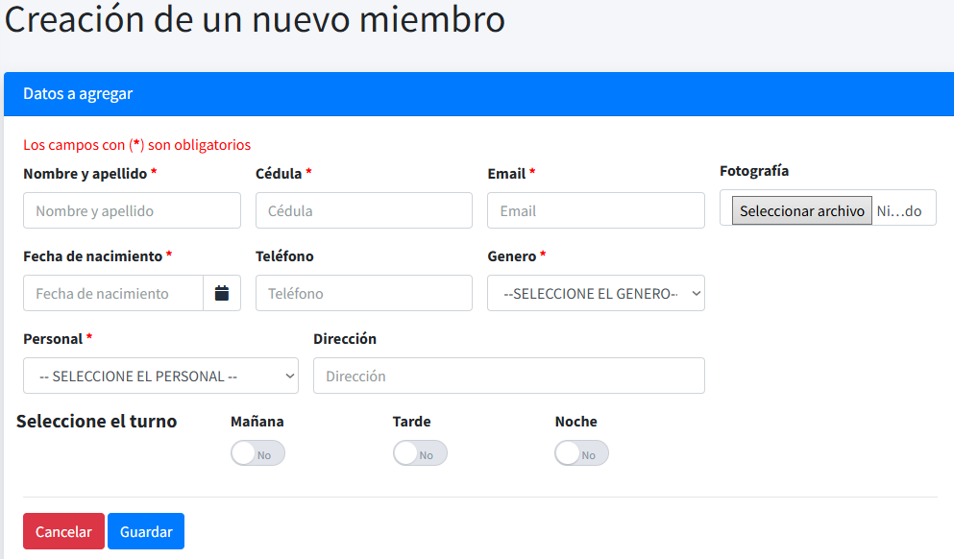
Members
The system manages registered Members, storing relevant personal information for identification and administration.
Add personal details, including the type of staff role.
Optionally, upload a photo of the user. If not provided, the system will assign an icon automatically based on their gender.
Assign the member’s work shift.
Save the entered data.

Slide 9
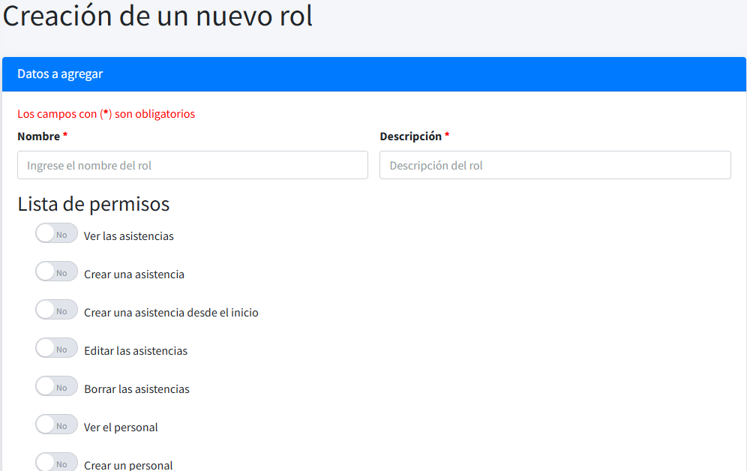
Roles and Permissions
The system uses a Roles and Permissions scheme to define the access level and actions each user can perform..
Define the role’s name.
Add a description of the role’s purpose.
Assign or remove permissions as needed.
Save the role.

Slide 10
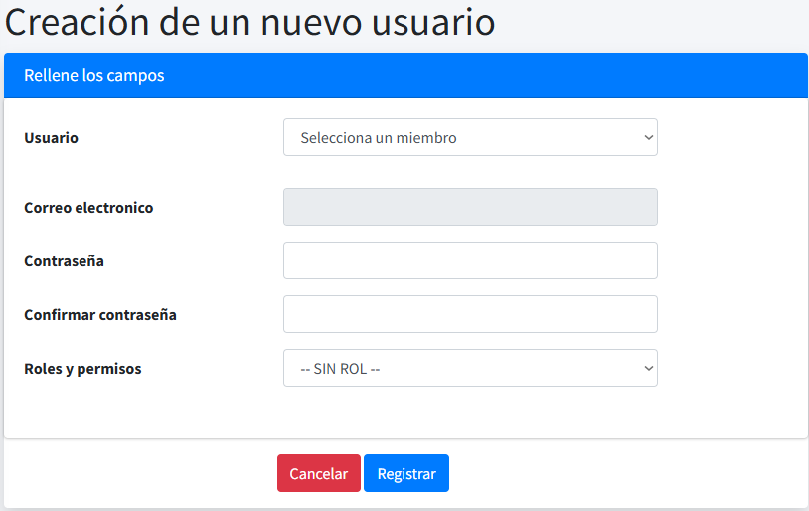
Users
User administration is a key functionality for proper system operation.
Select the member to be assigned a user account.
The email will be assigned automatically.
Create a password.
Assign roles and permissions.
Register the user.

Slide 11
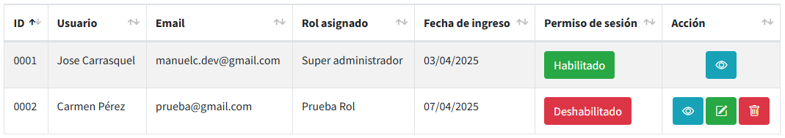
Users
Enable/Disable a User: This button is useful for users who cannot or should not be deleted.
ENABLED:
The user has full system access according to their role.
DISABLED:
The user is restricted from accessing the system without deleting their account.

Slide 12
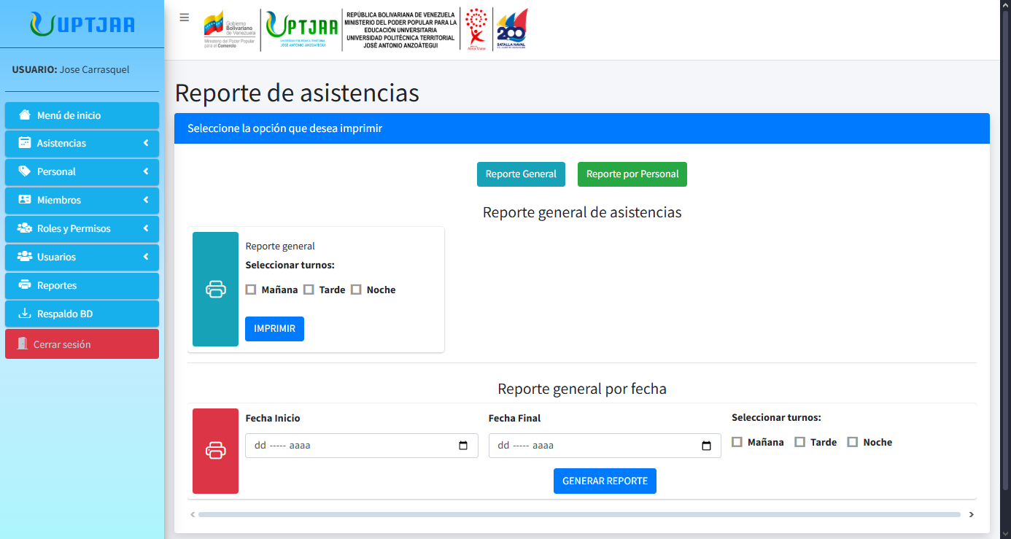
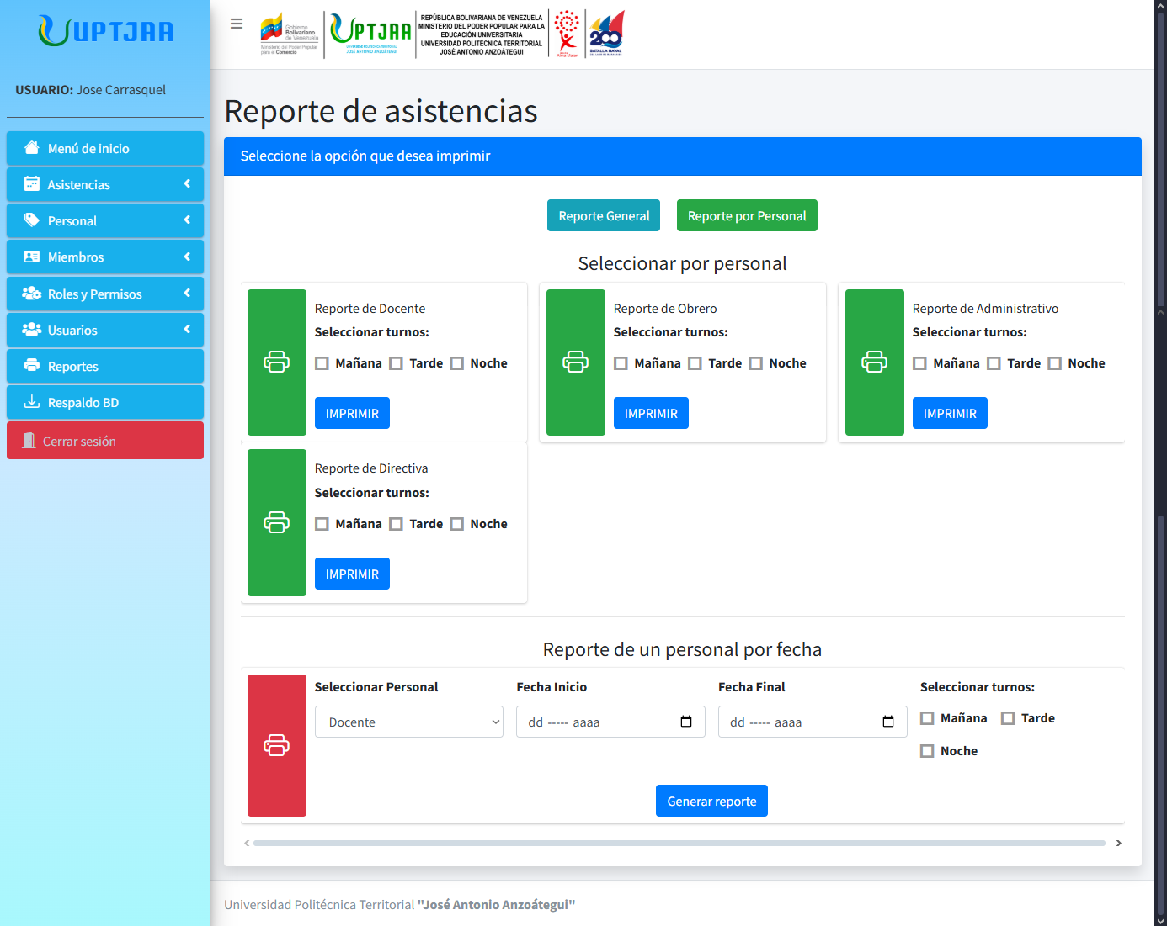
Reports
The system generates customizable PDF reports according to various criteria:
GENERAL:
Includes all attendances, from the first to the most recent.
BY STAFF TYPE:
Displays attendances for a specific staff type.
DATE RANGE:
Generates a report for attendances within a chosen time range.

Slide 13
Database Backup
A button located in the Sidebar allows automatic database backup, ensuring all registered information is safely stored.
With a single click, the database will be backed up quickly and efficiently, protecting data against unexpected issues.
Important Note: This button is only available according to the permissions assigned by the Administrator.

Slide 14
Security and Best Practices
To guarantee information security and proper use of the system, the following is recommended:
Use secure passwords and change them regularly. Passwords should be complex and contain a mix of letters, numbers, and special characters.
Do not share credentials with third parties. Each user is responsible for their own access.
Log out after each session. Especially important when using shared computers.
Report suspicious activities to the administrator. Unusual behaviors or unauthorized access should be reported immediately.
Staff training. It is essential to train all staff on how to use the system. This ensures users feel comfortable, reduces errors, and improves efficiency.

